Slide 1

Major Cybersecurity Incidents
CEP 146 Project

Slide 2

Historical Event (Historical Perspective)
Global Case (Global Focus)
Canadian Case (Local Focus)

Slide 3
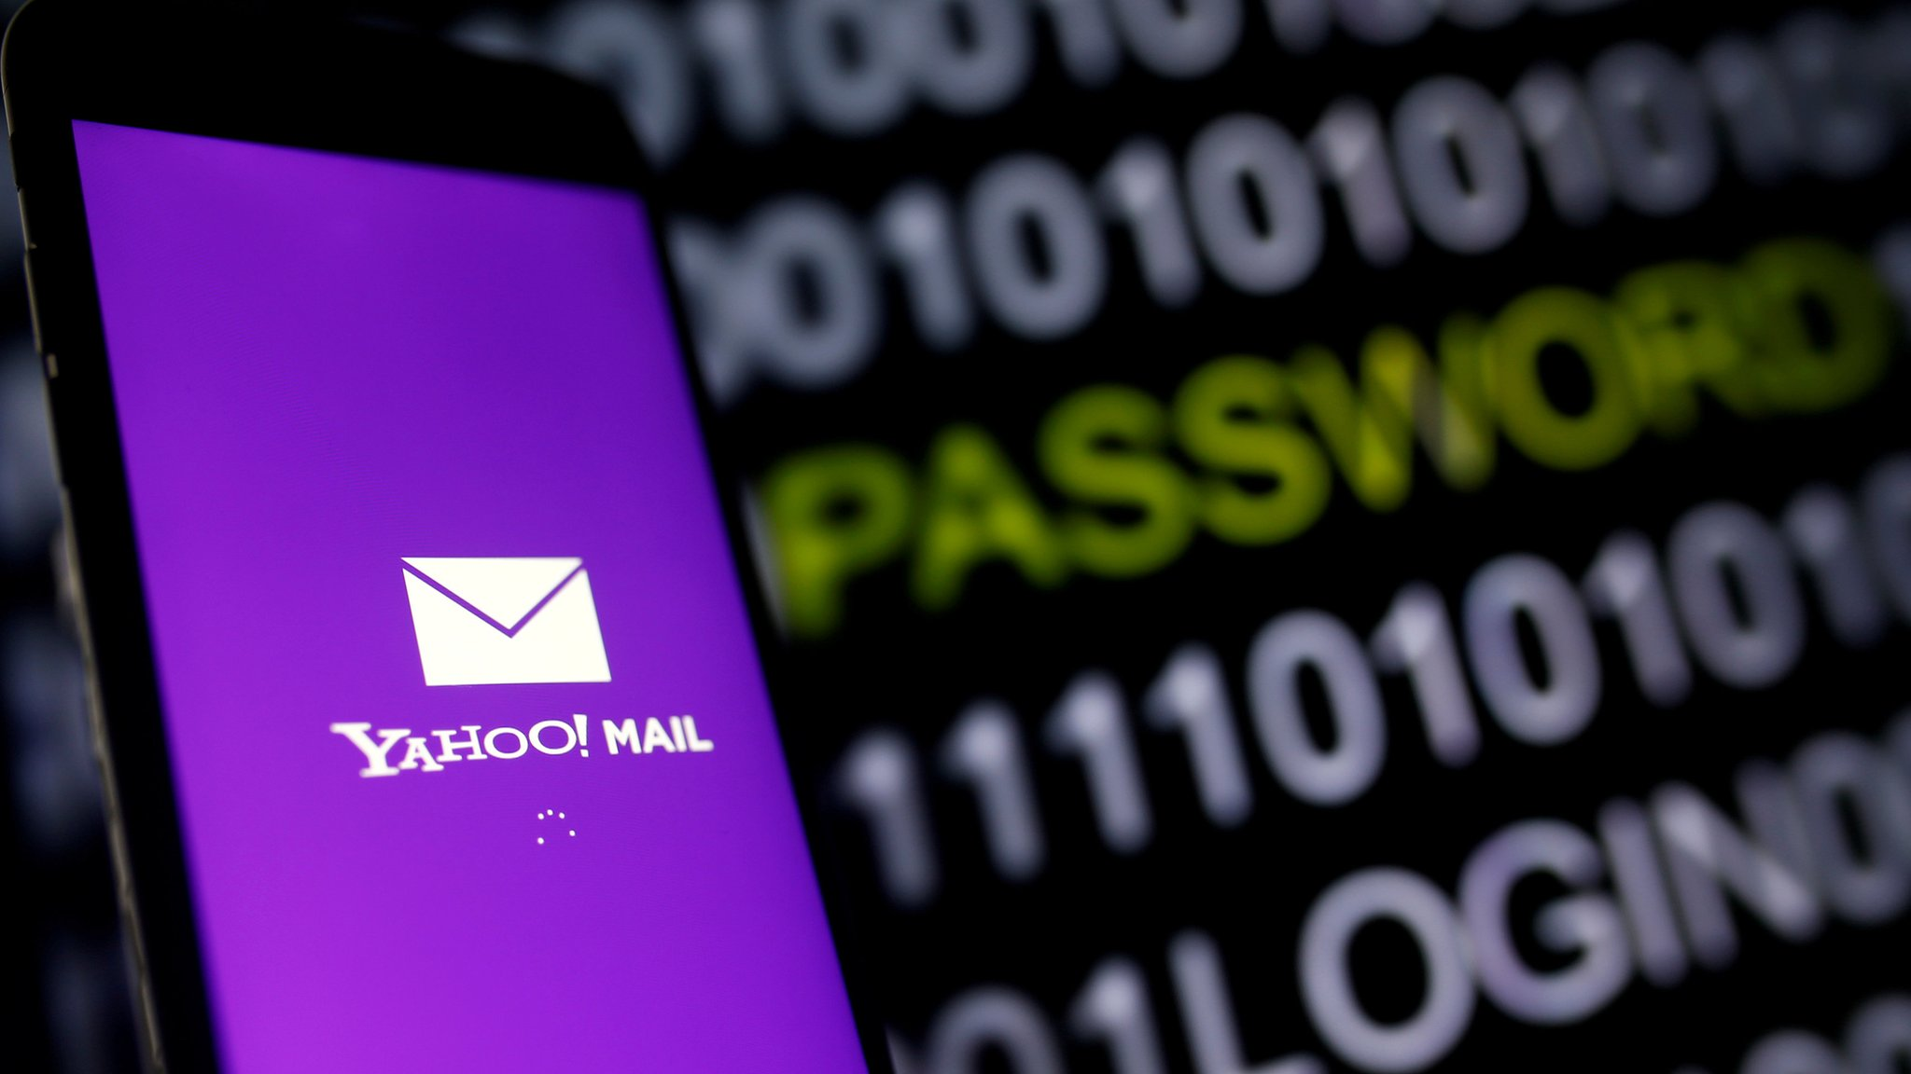

Yahoo Data Breach (2014)
- Over 500 million users affected
- Yahoo revealed the breach two years later
- Linked to Russian hackers (FSB)
- Used phishing emails to steal user data
- Led to loss of trust and lawsuits
- Verizon cut $350M from Yahoo’s sale price
Reference: [Netwrix Community] (https://blog.netwrix.com/biggest-cyber-attacks-in-history "The Largest and Most Notorious Cyber Attacks in History")

Slide 4

-
"WannaCry" attack
(2017)
- Cyberattacks have become more advanced and destructive as technology advanced
- Cyberattacks can have devastating effects that can be felt worldwide
- One of the biggest and most relevant global attacks was the "WannaCry" attack of 2017

Slide 5

- 79 stores closed for a week Hackers
- Demanded $25M, not paid
- Some internal data leaked
- No customer data affected
- Shows rising cyber risks in Canada
(2024)

Slide 6

Conclusion

